Slide 1
NLP in IJCAI 2019
Pin Ni
Sept. 16, 2019

Slide 2
Contents
Reading the selected papers in the field of NLP in IJCAI 2019
Overview
Paper 1: Coreference Aware Representation Learning for Neural Named Entity Recognition. Dai et al. (2019)
Paper 2: CNN-Based Chinese NER with Lexicon Rethinking. Gui et al. (2019)
Paper 3: Learning Task-specific Representation for Novel Words in Sequence Labeling. Peng et al. (2019)
Paper 4: Adversarial Transfer for Named Entity Boundary Detection with Pointer Networks. Li et al. (2019)
Review of hot topics on Workshops
Paper 1: Leveraging BERT to Improve the FEARS Index for Stock Forecasting (FinNLP)
Paper 2: Ex-Twit: Explainable Twitter Mining on Health Data (SocialNLP)
Discussion of IJCAI’s NLP in Academia and Industry

Slide 3
Overview of NLP in IJCAI 2019
More than 8,000 papers were submitted to IJCAI 2019, and a total of 847 papers were accepted [1].
Among them, 84 papers in the field of NLP were accepted, accounting for 9.91% of the total number of accepted papers [1], which was down from 95 papers last year.
Mainly focus on Sentiment Analysis, Cross-Modal Information, Information Retrieval, Text Classification, Q&A, Visual Dialog, Word Embedding, Knowledge Representation, Text style transfer, Named Entity Recognition, Sentiment detection, Relation Extraction, Network Embedding, Text Generation, Machine Translation etc.

Slide 4
Overview of NLP in IJCAI 2019
Distant Supervision: Early Discovery of Emerging Entities in Microblogs https: //www.ijcai.org/proceedings/2019/678
Q&A: Neural Program Induction for KBQA Without Gold Programs or Query Annotations https: //www.ijcai.org/proceedings/2019/679
Medical Conceptual Representation: Medical Concept Representation Learning from Multi-source Data https: //www.ijcai.org/proceedings/2019/680
Sentiment Classification: Multi-Domain Sentiment Classification Based on Domain-Aware Embedding and Attention https: //www.ijcai.org/proceedings/2019/681
Relationship Representation: A Latent Variable Model for Learning Distributional Relation Vectors https: //www.ijcai.org/proceedings/2019/682
Relational Semantic Mapping: Generating Multiple Diverse Responses with Multi-Mapping and Posterior Mapping Selection https: //www.ijcai.org/proceedings/2019/683
Poetry Generation: Sentiment-Controllable Chinese Poetry Generation https: //www.ijcai.org/proceedings/2019/684
Machine Translation: From Words to Sentences: A Progressive Learning Approach for Zero-resource Machine Translation with Visual Pivots https: //www.ijcai.org/proceedings/2019/685
Abstractive Timeline Summarization: Learning towards Abstractive Timeline Summarization https: //www.ijcai.org/proceedings/2019/686
Named Entity Recognition: Coreference Aware Representation Learning for Neural Named Entity Recognition https: //www.ijcai.org/proceedings/2019/687
Multi-output learning: Learning Assistance from an Adversarial Critic for Multi-Outputs Prediction https: //www.ijcai.org/proceedings/2019/688
Entity Resolution: End-to-End Multi-Perspective Matching for Entity Resolution https: //www.ijcai.org/proceedings/2019/689
Reading Comprehension: Difficulty Controllable Generation of Reading Comprehension Questions https: //www.ijcai.org/proceedings/2019/690
Syntactic and Semantic Parsing: Modeling Source Syntax and Semantics for Neural AMR Parsing https: //www.ijcai.org/proceedings/2019/691
Chinese Named Entity Recognition: CNN-Based Chinese NER with Lexicon Rethinking https: //www.ijcai.org/proceedings/2019/692
Visual Dialog: Dual Visual Attention Network for Visual Dialog https: //www.ijcai.org/proceedings/2019/693
Q&A: AmazonQA: A Review-Based Question Answering Task https: //www.ijcai.org/proceedings/2019/694
Causal Q&A: Answering Binary Causal Questions Through Large-Scale Text Mining: An Evaluation Using Cause-Effect Pairs from Human Experts https: //www.ijcai.org/proceedings/2019/695
Dialogue Modeling: GSN: A Graph-Structured Network for Multi-Party Dialogues https: //www.ijcai.org/proceedings/2019/696
Text Classification: Leap-LSTM: Enhancing Long Short-Term Memory for Text Categorization https: //www.ijcai.org/proceedings/2019/697
Relation Extraction: Relation Extraction Using Supervision from Topic Knowledge of Relation Labels https: //www.ijcai.org/proceedings/2019/698
Represent Learning Similarity: Representation Learning with Weighted Inner Product for Universal Approximation of General Similarities https: //www.ijcai.org/proceedings/2019/699

Slide 5
Overview of NLP in IJCAI 2019
Coreference Resolution: Incorporating Structural Information for Better Coreference Resolution https: //www.ijcai.org/proceedings/2019/700
Entity-Linking, Topic Units: Knowledge Base Question Answering with Topic Units https: //www.ijcai.org/proceedings/2019/701
Named Entity Boundary Detection: Adversarial Transfer for Named Entity Boundary Detection with Pointer Networks https: //www.ijcai.org/proceedings/2019/702
Speech Emotion Recognition, Representation Learning: Towards Discriminative Representation Learning for Speech Emotion Recognition https: //www.ijcai.org/proceedings/2019/703
Dependency Parsing: Self-attentive Biaffine Dependency Parsing https: //www.ijcai.org/proceedings/2019/704
Improved GRU: Reading selectively via Binary Input Gated Recurrent Unit https: //www.ijcai.org/proceedings/2019/705
Dialog Systems: Learning to Select Knowledge for Response Generation in Dialog Systems https: //www.ijcai.org/proceedings/2019/706
Sentiment Classification: Deep Mask Memory Network with Semantic Dependency and Context Moment for Aspect Level Sentiment Classification https: //www.ijcai.org/proceedings/2019/707
Cross-Modal Information for Image Captioning: Exploring and Distilling Cross-Modal Information for Image Captioning https: //www.ijcai.org/proceedings/2019/708
Network Embedding: Network Embedding with Dual Generation Tasks https: //www.ijcai.org/proceedings/2019/709
Interactive Search: Building Personalized Simulator for Interactive Search https: //www.ijcai.org/proceedings/2019/710
Text Style Transfer: A Dual Reinforcement Learning Framework for Unsupervised Text Style Transfer https: //www.ijcai.org/proceedings/2019/711
Aspect Extraction: Unsupervised Neural Aspect Extraction with Sememes https: //www.ijcai.org/proceedings/2019/712
Sentiment Classification: Aspect-Based Sentiment Classification with Attentive Neural Turing Machines https: //www.ijcai.org/proceedings/2019/714
OOV: Learning Task-Specific Representation for Novel Words in Sequence Labeling https: //www.ijcai.org/proceedings/2019/715
Dependency and Relation Extraction: Improving Cross-Domain Performance for Relation Extraction via Dependency Prediction and Information Flow Control https: //www.ijcai.org/proceedings/2019/716
Sentiment Analysis: Learn to Select via Hierarchical Gate Mechanism for Aspect-Based Sentiment Analysis https: //www.ijcai.org/proceedings/2019/717
Aligning Learning: Aligning Learning Outcomes to Learning Resources: A Lexico-Semantic Spatial Approach https: //www.ijcai.org/proceedings/2019/718
Code Switched Text: A Deep Generative Model for Code Switched Text https: //www.ijcai.org/proceedings/2019/719
Image-Text Matching: Knowledge Aware Semantic Concept Expansion for Image-Text Matching https: //www.ijcai.org/proceedings/2019/720
Conversational Responses: Exploiting Persona Information for Diverse Generation of Conversational Responses https: //www.ijcai.org/proceedings/2019/721
Sentiment Analysis: Cold-Start Aware Deep Memory Network for Multi-Entity Aspect-Based Sentiment Analysis https: //www.ijcai.org/proceedings/2019/722

Slide 6
Overview of NLP in IJCAI 2019
GAN, Spam Detection: GANs for Semi-Supervised Opinion Spam Detection https: //www.ijcai.org/proceedings/2019/723
Semantic Language Representation , Financial Forecast: PRoFET: Predicting the Risk of Firms from Event Transcripts https: //www.ijcai.org/proceedings/2019/724
Knowledge Embedding: Unsupervised Embedding Enhancements of Knowledge Graphs using Textual Associations https: //www.ijcai.org/proceedings/2019/725
Image Captioning Transformation: Swell-and-Shrink: Decomposing Image Captioning by Transformation and Summarization https: //www.ijcai.org/proceedings/2019/726
Story Completion: T-CVAE: Transformer-Based Conditioned Variational Autoencoder for Story Completion https: //www.ijcai.org/proceedings/2019/727
Link Prediction: Robust Embedding with Multi-Level Structures for Link Prediction https: //www.ijcai.org/proceedings/2019/728
Generation of Semantic Structure of Text (Mind-map): Revealing Semantic Structures of Texts: Multi-grained Framework for Automatic Mind-map Generation https: //www.ijcai.org/proceedings/2019/729
Machine Translation: Correct-and-Memorize: Learning to Translate from Interactive Revisions https: //www.ijcai.org/proceedings/2019/730
Text Modeling: Modeling Noisy Hierarchical Types in Fine-Grained Entity Typing: A Content-Based Weighting Approach https: //www.ijcai.org/proceedings/2019/731
Sentiment Transfer: Mask and Infill: Applying Masked Language Model for Sentiment Transfer https: //www.ijcai.org/proceedings/2019/732
Entity Alignment: Relation-Aware Entity Alignment for Heterogeneous Knowledge Graphs https: //www.ijcai.org/proceedings/2019/733
Emotion Cause Extraction: RTHN: A RNN-Transformer Hierarchical Network for Emotion Cause Extraction https: //www.ijcai.org/proceedings/2019/734
Transformer Variant: Sharing Attention Weights for Fast Transformer https: //www.ijcai.org/proceedings/2019/735
Semi-Supervised Text Matching: Dual-View Variational Autoencoders for Semi-Supervised Text Matching https: //www.ijcai.org/proceedings/2019/737
Aspect-Based Sentiment Analysis: Earlier Attention? Aspect-Aware LSTM for Aspect-Based Sentiment Analysis https: //www.ijcai.org/proceedings/2019/738
Machine Translation: Polygon-Net: A General Framework for Jointly Boosting Multiple Unsupervised Neural Machine Translation Models https: //www.ijcai.org/proceedings/2019/739
Entity Linking: Neural Collective Entity Linking Based on Recurrent Random Walk Network Learning https: //www.ijcai.org/proceedings/2019/740
Adversarial Example: Robust Audio Adversarial Example for a Physical Attack https: //www.ijcai.org/proceedings/2019/741
Image Captioning: HorNet: A Hierarchical Offshoot Recurrent Network for Improving Person Re-ID via Image Captioning https: //www.ijcai.org/proceedings/2019/742
Q&A: Knowledge-enhanced Hierarchical Attention for Community Question Answering with Multi-task and Adaptive Learning https: //www.ijcai.org/proceedings/2019/743
Commonsense-Driven Visual Story Generation: Knowledgeable Storyteller: A Commonsense-Driven Generative Model for Visual Storytelling https: //www.ijcai.org/proceedings/2019/744
Network Embedding: Triplet Enhanced AutoEncoder: Model-free Discriminative Network Embedding https: //www.ijcai.org/proceedings/2019/745

Slide 7
Overview of NLP in IJCAI 2019
Multilingual Sentence Embedding: Improving Multilingual Sentence Embedding using Bi-directional Dual Encoder with Additive Margin Softmax https: //www.ijcai.org/proceedings/2019/746
Text Style Transfer: Utilizing Non-Parallel Text for Style Transfer by Making Partial Comparisons https: //www.ijcai.org/proceedings/2019/747
Sentence Representation: Graph-based Neural Sentence Ordering https: //www.ijcai.org/proceedings/2019/748
Word Representation: Refining Word Representations by Manifold Learning https: //www.ijcai.org/proceedings/2019/749
Relation Extraction: Beyond Word Attention: Using Segment Attention in Neural Relation Extraction https: //www.ijcai.org/proceedings/2019/750
Multimodal Sentiment Classification: Adapting BERT for Target-Oriented Multimodal Sentiment Classification https: //www.ijcai.org/proceedings/2019/751
Emotion Detection: Modeling both Context-and Speaker-Sensitive Dependence for Emotion Detection in Multi-speaker Conversations https: //www.ijcai.org/proceedings/2019/752
Entity and Event Extraction: Extracting Entities and Events as a Single Task Using a Transition-Based Neural Model https: //www.ijcai.org/proceedings/2019/753
Entity Alignment Embedding: Multi-view Knowledge Graph Embedding for Entity Alignment https: //www.ijcai.org/proceedings/2019/754
Conversational Sentiment Analysis: Quantum-Inspired Interactive Networks for Conversational Sentiment Analysis https: //www.ijcai.org/proceedings/2019/755
Information Retrieval: A Document-grounded Matching Network for Response Selection in Retrieval-based Chatbots https: //www.ijcai.org/proceedings/2019/756
Text Classification: Recurrent Neural Network for Text Classification with Hierarchical Multiscale Dense Connections https: //www.ijcai.org/proceedings/2019/757
Information Retrieval: RLTM: An Efficient Neural IR Framework for Long Documents https: //www.ijcai.org/proceedings/2019/758
Text Classification: Dynamically Route Hierarchical Structure Representation to Attentive Capsule for Text Classification https: //www.ijcai.org/proceedings/2019/759
Sequence Generation: Sequence Generation: From Both Sides to the Middle https: //www.ijcai.org/proceedings/2019/760
Word Embedding: Getting in Shape: Word Embedding SubSpaces https: //www.ijcai.org/proceedings/2019/761
Opinion Target Extraction, Sentiment Classification: A Span-based Joint Model for Opinion Target Extraction and Target Sentiment Classification https: //www.ijcai.org/proceedings/2019/762

Slide 8
Reading the selected papers in the field of NLP in IJCAI 2019
Coreference Aware Representation Learning for Neural Named Entity Recognition
“Recent neural network models have achieved the state-of-the-art performance on the task of named entity recognition (NER). However, previous neural network models typically treat the input sentences as a linear sequence of words but ignore rich structural information, such as the coreference relations among non-adjacent words, phrases or entities. In this paper, we propose a novel approach to learn coreference-aware word representations for the NER task at the document level. In particular, we enrich the well-known neural architecture “CNN-BiLSTM-CRF” with a coreference layer on top of the BiLSTM layer to incorporate coreferential relations. Furthermore, we introduce the coreference regularization to ensure the coreferential entities to share similar representations and consistent predictions within the same coreference cluster. Our proposed model achieves new state-of-theart performance on two NER benchmarks: CoNLL2003 and OntoNotes v5.0. More importantly, we demonstrate that our framework does not rely on gold coreference knowledge, and can still work well even when the coreferential relations are generated by a third-party toolkit. ”
Dai et al. (2019)

Slide 9
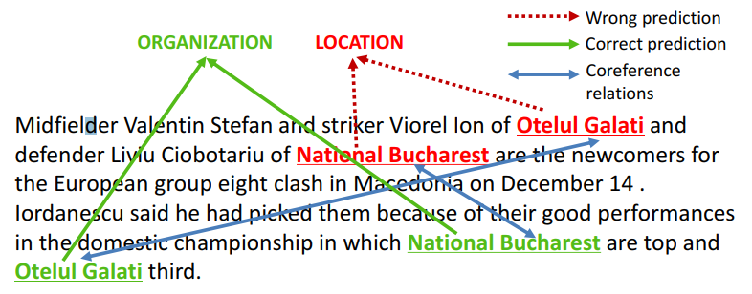
Reading the selected papers in the field of NLP in IJCAI 2019
Coreference Aware Representation Learning for Neural Named Entity Recognition
Dai et al. (2019)

Slide 10
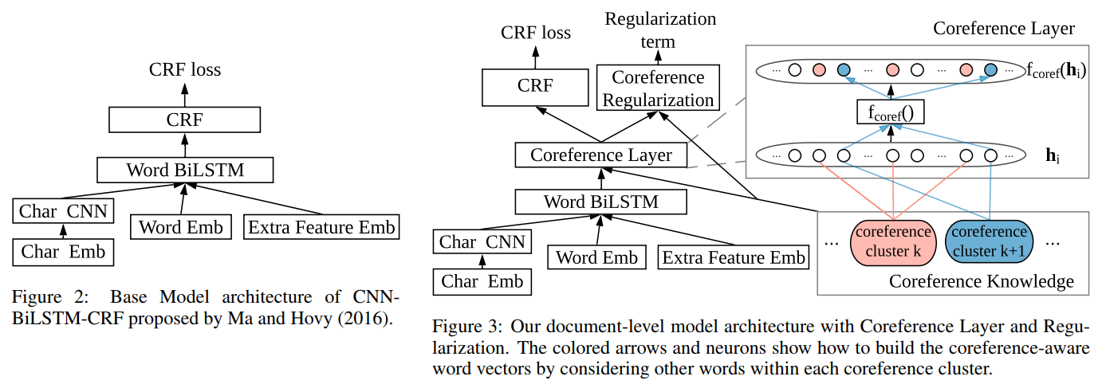
Reading the selected papers in the field of NLP in IJCAI 2019
Coreference Aware Representation Learning for Neural Named Entity Recognition
Dai et al. (2019)

Slide 11
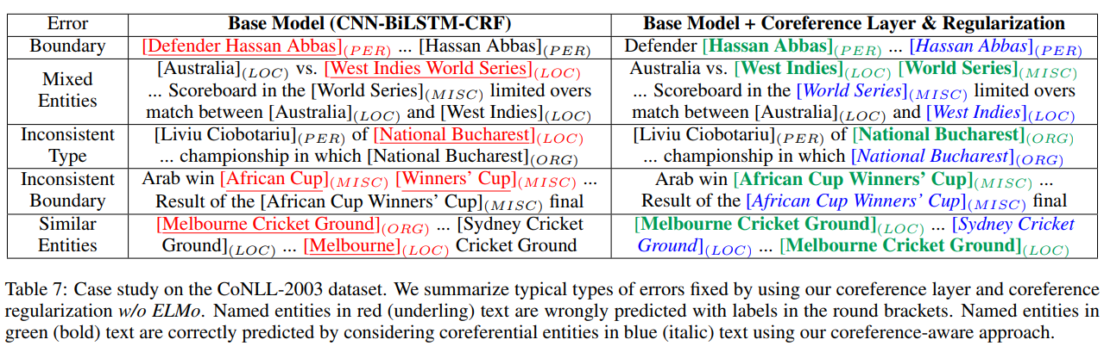
Reading the selected papers in the field of NLP in IJCAI 2019
Coreference Aware Representation Learning for Neural Named Entity Recognition
Dai et al. (2019)

Slide 12
Reading the selected papers in the field of NLP in IJCAI 2019
CNN-Based Chinese NER with Lexicon Rethinking
“Character-level Chinese named entity recognition (NER) that applies long short-term memory (LSTM) to incorporate lexicons has achieved great success. However, this method fails to fully exploit GPU parallelism and candidate lexicons can conflict. In this work, we propose a faster alternative to Chinese NER: a convolutional neural network (CNN)-based method that incorporates lexicons using a rethinking mechanism. The proposed method can model all the characters and potential words that match the sentence in parallel. In addition, the rethinking mechanism can address the word conflict by feeding back the high-level features to refine the networks. Experimental results on four datasets show that the proposed method can achieve better performance than both word-level and character-level baseline methods. In addition, the proposed method performs up to 3.21 times faster than state-of-the-art methods, while realizing better performance. ”
Gui et al. (2019)

Slide 13
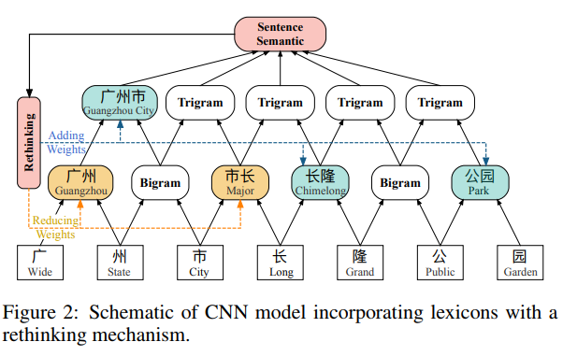
Reading the selected papers in the field of NLP in IJCAI 2019
CNN-Based Chinese NER with Lexicon Rethinking
Gui et al. (2019)

Slide 14
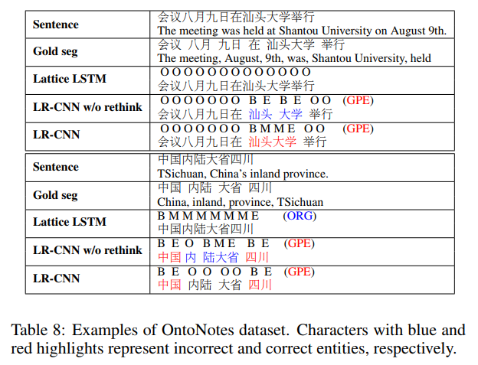
Reading the selected papers in the field of NLP in IJCAI 2019
CNN-Based Chinese NER with Lexicon Rethinking
Gui et al. (2019)

Slide 15
Reading the selected papers in the field of NLP in IJCAI 2019
Learning Task-specific Representation for Novel Words in Sequence Labeling
“Word representation is a key component in neural-network-based sequence labeling systems. However, representations of unseen or rare words trained on the end task are usually poor for appreciable performance. This is commonly referred to as the out-of-vocabulary (OOV) problem. In this work, we address the OOV problem in sequence labeling using only training data of the task. To this end, we propose a novel method to predict representations for OOV words from their surface-forms (e.g., character sequence) and contexts. The method is specifically designed to avoid the error propagation problem suffered by existing approaches in the same paradigm. To evaluate its effectiveness, we performed extensive empirical studies on four part-of-speech tagging (POS) tasks and four named entity recognition (NER) tasks. Experimental results show that the proposed method can achieve better or competitive performance on the OOV problem compared with existing state-of-the-art methods.”
Peng et al. (2019)

Slide 16
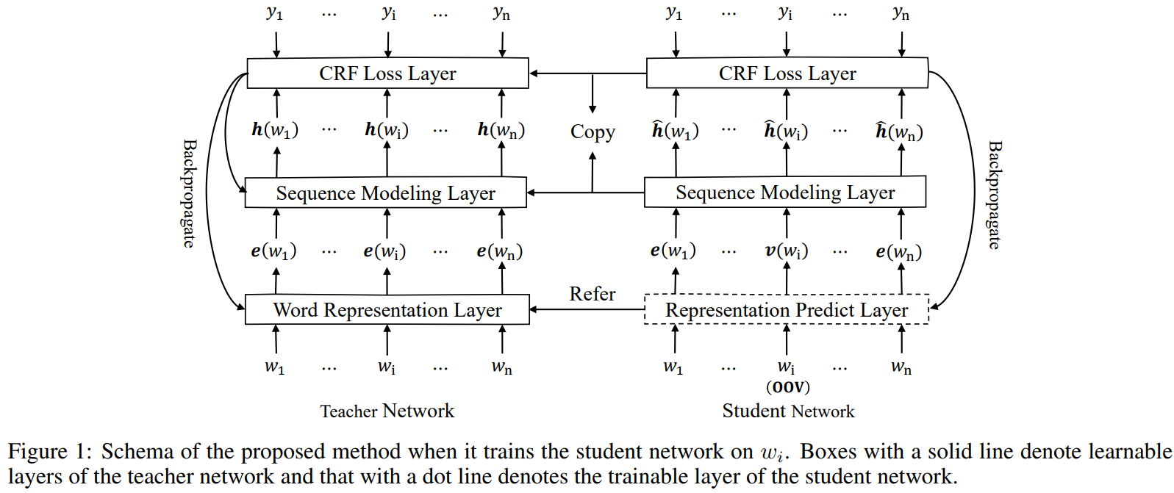
Reading the selected papers in the field of NLP in IJCAI 2019
Learning Task-specific Representation for Novel Words in Sequence Labeling
Peng et al. (2019)

Slide 17
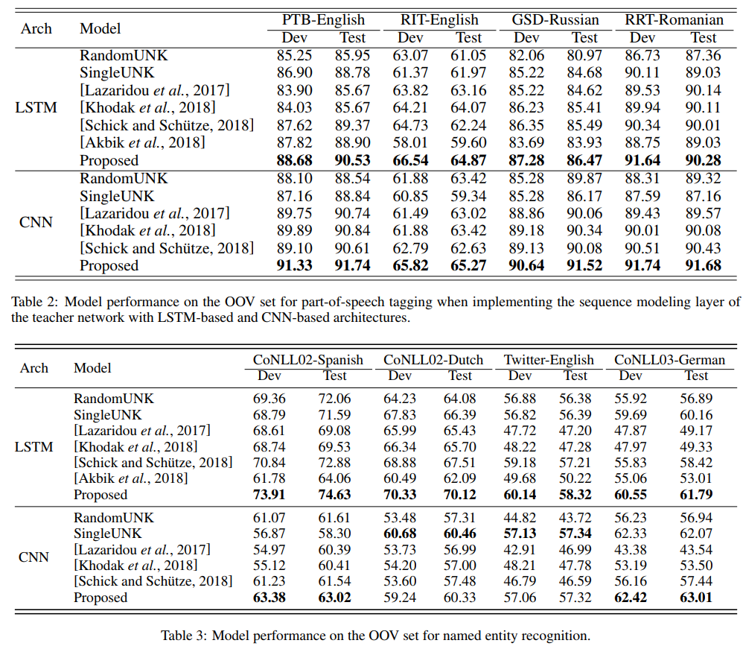
Reading the selected papers in the field of NLP in IJCAI 2019
Learning Task-specific Representation for Novel Words in Sequence Labeling
Peng et al. (2019)

Slide 18
Reading the selected papers in the field of NLP in IJCAI 2019
Adversarial Transfer for Named Entity Boundary Detection with Pointer Networks
“In this paper, we focus on named entity boundary detection, which aims to detect the start and end boundaries of an entity mention in text, without predicting its type. A more accurate and robust detection approach is desired to alleviate error propagation in downstream applications, such as entity linking and fine-grained typing systems. Here, we first develop a novel entity boundary labeling approach with pointer networks, where the output dictionary size depends on the input, which is variable. Furthermore, we propose AT-Bdry, which incorporates adversarial transfer learning into an end-to-end sequence labeling model to encourage domain-invariant representations. More importantly, AT-Bdry can reduce domain difference in data distributions between the source and target domains, via an unsupervised transfer learning approach (i.e., no annotated target-domain data is necessary). We conduct Formal Text to Formal Text, Formal Text to Informal Text and ablation evaluations on five benchmark datasets. Experimental results show that AT-Bdry achieves state-of-the-art transferring performance against recent baselines. ”
Li et al. (2019)

Slide 19
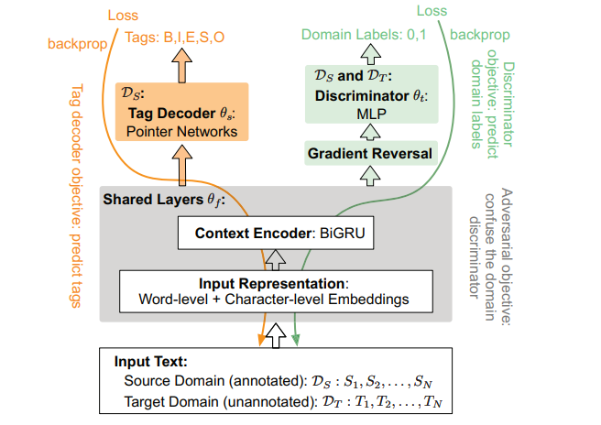
Reading the selected papers in the field of NLP in IJCAI 2019
Adversarial Transfer for Named Entity Boundary Detection with Pointer Networks
Li et al. (2019)

Slide 20
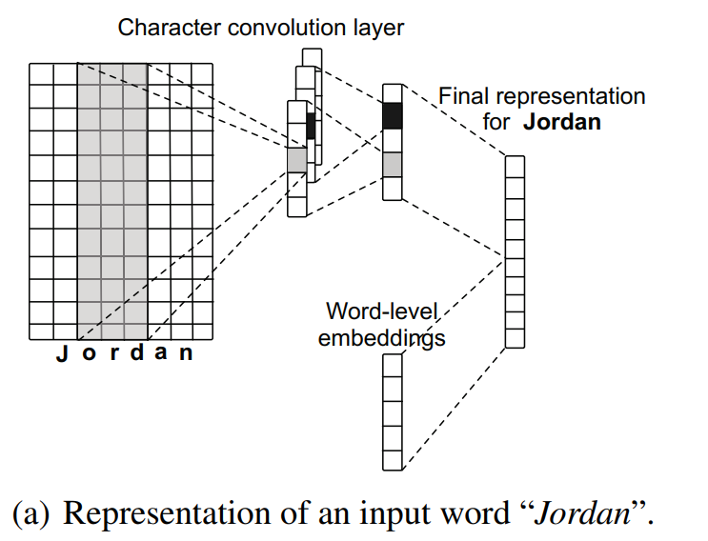
Reading the selected papers in the field of NLP in IJCAI 2019
Adversarial Transfer for Named Entity Boundary Detection with Pointer Networks
Li et al. (2019)

Slide 21
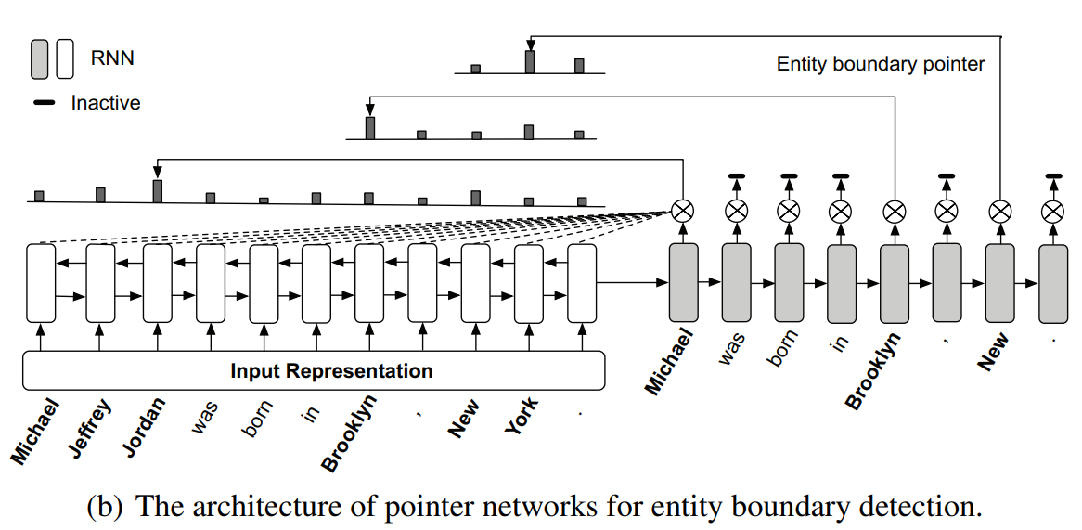
Reading the selected papers in the field of NLP in IJCAI 2019
Adversarial Transfer for Named Entity Boundary Detection with Pointer Networks
Li et al. (2019)

Slide 22
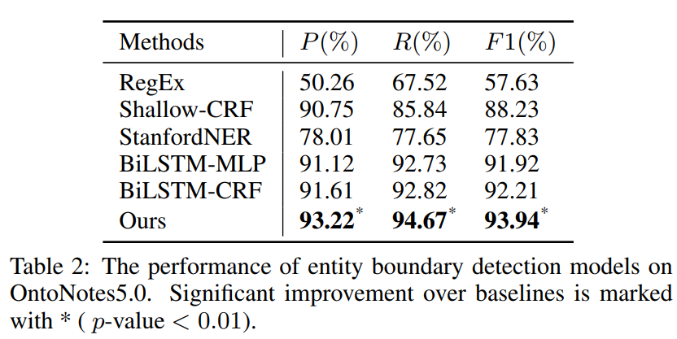
Reading the selected papers in the field of NLP in IJCAI 2019
Adversarial Transfer for Named Entity Boundary Detection with Pointer Networks
Li et al. (2019)

Slide 23
Review of hot topics on Workshops
W4 Financial Technology and Natural Language Processing (FinNLP)
W11 Semantic Deep Learning (SemDeep)
W12 Big Social Media Data Management and Analysis (BSMDMA)
W16 Linguistic and Cognitive Approaches to Dialogue Agents (LaCATODA)
W17 Bringing Semantic Knowledge into Vision and Text Understanding
W22 Search-Oriented Conversational AI (SCAI)
W31 Language Sense on Computer
W45 Natural Language Processing for Social Media (SocialNLP)

Slide 24
Review of hot topics on Workshops
W4 Financial Technology and Natural Language Processing (FinNLP)
Leveraging BERT to Improve the FEARS Index for Stock Forecasting
“Financial and Economic Attitudes Revealed by Search (FEARS) index reflects the attention and sentiment of public investors and is an important factor for predicting stock price return. In this paper, we take into account the semantics of the FEARS search terms by leveraging the Bidirectional Encoder Representations from Transformers (BERT), and further apply a self-attention deep learning model to our refined FEARS seamlessly for stock return prediction. We demonstrate the practical benefits of our approach by comparing to baseline works.”
Yang et al. (2019)

Slide 25
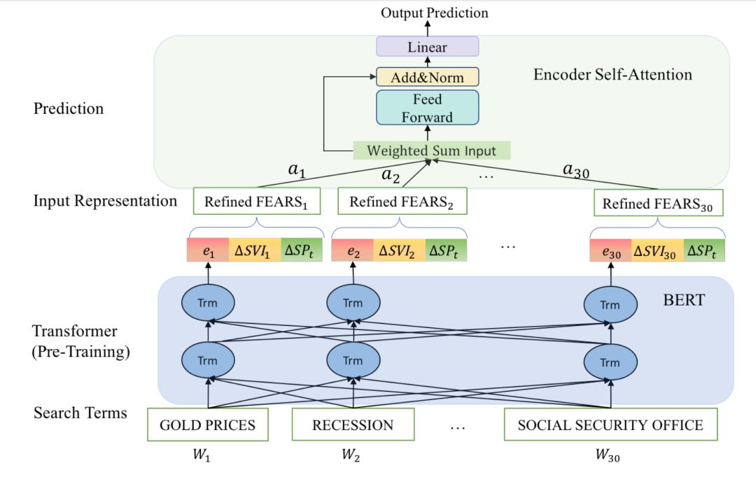
Review of hot topics on Workshops
Yang et al. (2019)

Slide 26
Review of hot topics on Workshops
W45 Natural Language Processing for Social Media (SocialNLP)
Ex-Twit: Explainable Twitter Mining on Health Data
“Since most machine learning models provide no explanations for the predictions, their predictions are obscure for the human. The ability to explain a model's prediction has become a necessity in many applications including Twitter mining. In this work, we propose a method called Explainable Twitter Mining (Ex-Twit) combining Topic Modeling and Local Interpretable Model-agnostic Explanation (LIME) to predict the topic and explain the model predictions. We demonstrate the effectiveness of Ex-Twit on Twitter health-related data.”
Islam et al. (2019)

Slide 27
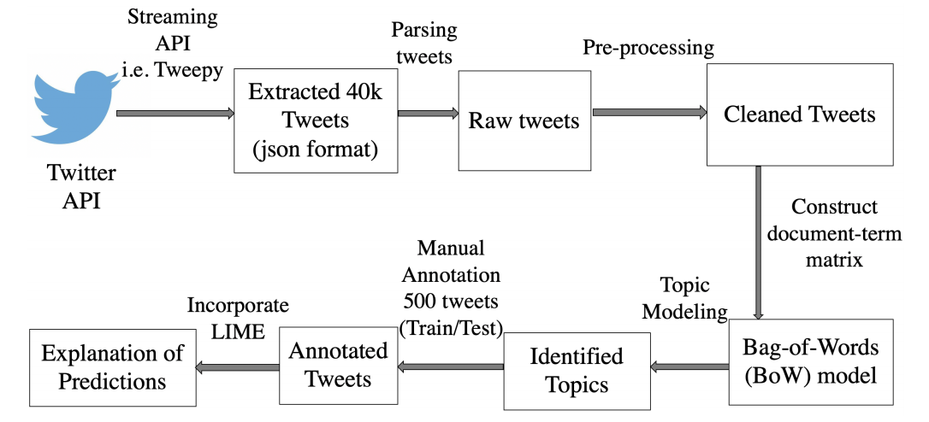
Review of hot topics on Workshops
W45 Natural Language Processing for Social Media (SocialNLP)
Ex-Twit: Explainable Twitter Mining on Health Data
Islam et al. (2019)

Slide 28
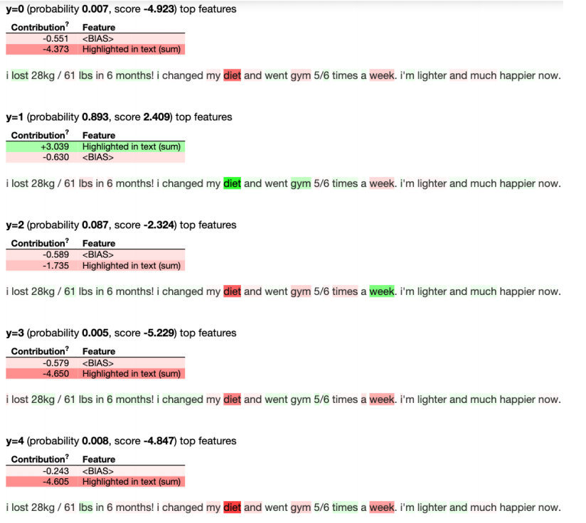
Review of hot topics on Workshops
Islam et al. (2019)

Slide 29
Discussion of IJCAI’s NLP in Academia and Industry
It covers a wide range of subjects and contributes from many different fields. Practical, not limited to academic research, many of the industry’s latest tools and emerging technology demo are also play an important role in this conference.
It is more integrative and has more frontier exploration in different fields than other domain conferences.
Participants are diverse and research fields vary. A large number of industry participants.
More papers tend to do research on current problems, and more papers prefer to use real-world datasets.

Slide 30
Reference
[1] IJCAI 2019: http: //ijcai19.org/
[2] Dai, Z., Fei, H., & Li, P. (2019). Coreference Aware Representation Learning for Neural Named Entity Recognition. In Proceedings of the International Joint Conference on Artificial Intelligence (IJCAI), Macau.
[3] Gui, T., Ma, R., Zhang, Q., Zhao, L., Jiang, Y. G., & Huang, X. (2019). CNN-Based Chinese NER with Lexicon Rethinking. In Proceedings of the International Joint Conference on Artificial Intelligence (IJCAI), Macau.
[4] Peng, M., Zhang, Q., Xing, X., Gui, T., Fu, J., & Huang, X. (2019). Learning Task-specific Representation for Novel Words in Sequence Labeling. In Proceedings of the International Joint Conference on Artificial Intelligence (IJCAI), Macau.
[5] Li, J., Ye, D., & Shang, S. (2019) Adversarial Transfer for Named Entity Boundary Detection with Pointer Networks. In Proceedings of the International Joint Conference on Artificial Intelligence (IJCAI), Macau.
[6] Yang, L., Dong, R., Ng, T. L. J., & Xu, Y. (2019). Leveraging BERT to Improve the FEARS Index for Stock Forecasting. In Proceedings of the First Workshop on Financial Technology and Natural Language Processing (pp. 54-60).
[7] Islam, T. (2019). Ex-Twit: Explainable Twitter Mining on Health Data. arXiv preprint arXiv: 1906.02132.

